Slide 1

THERMODYNAMICS I (ME 265)
FIRST LAW OF THERMODYNAMICS
APPLIED TO CLOSED SYSTEMS
Francis Kofi Forson (Professor)
Department of Mechanical Engineering
Kwame Nkrumah University of Science and Technology, Kumasi, Ghana

Slide 2
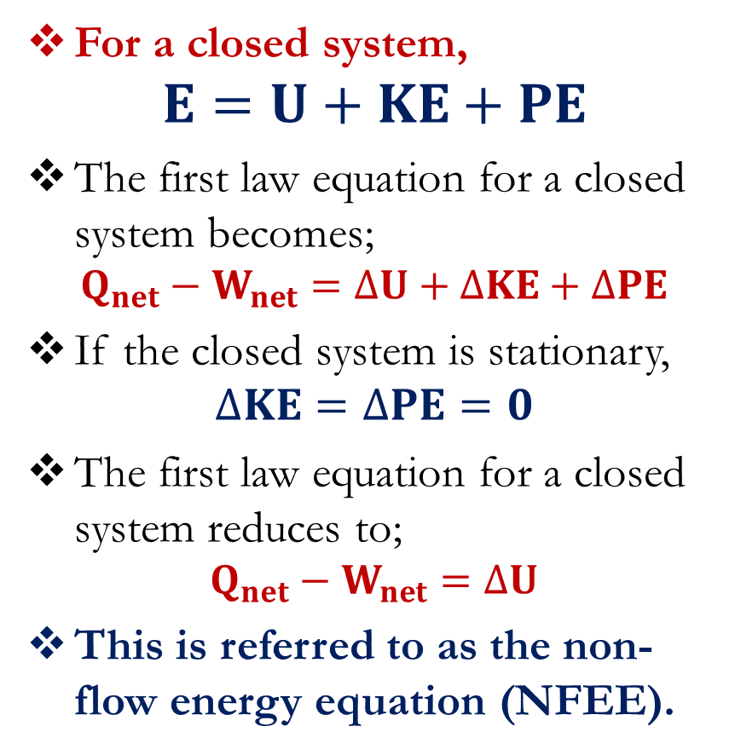
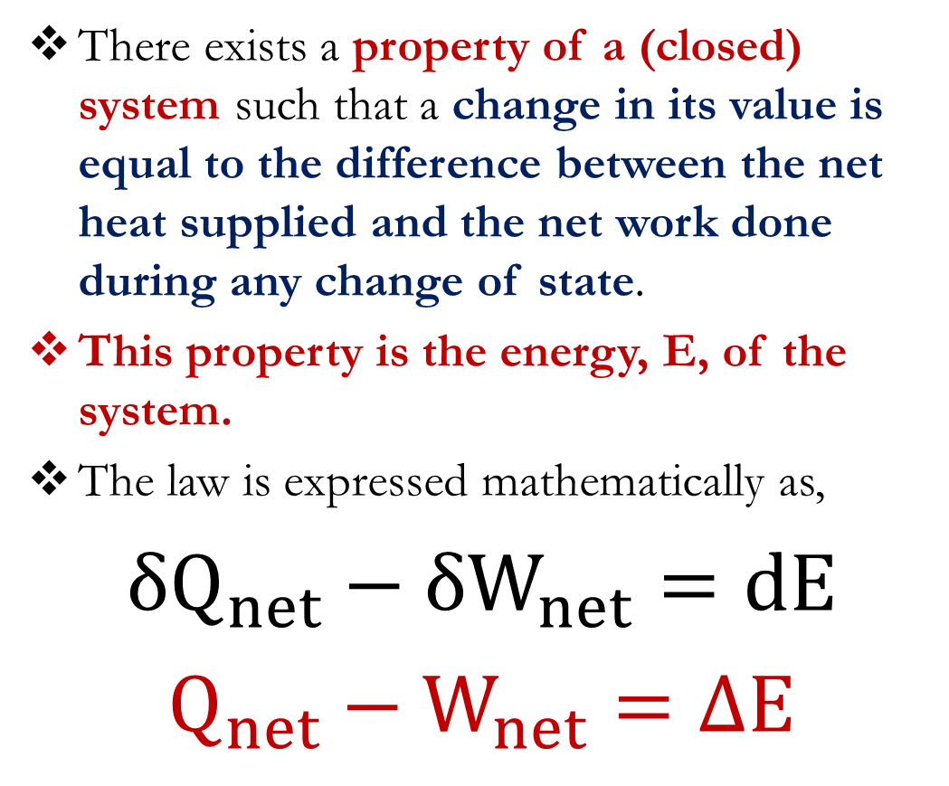
First Law of Thermodynamics
There exists a property of a (closed) system such that a change in its value is equal to the difference between the net heat supplied and the net work done during any change of state.
This property is the energy, E, of the system.
The law is expressed mathematically as,
$${δQ}_{net}−{δW}_{net}=dE$$
$$Q_{net}−W_{net}=∆E$$
For a closed system,
$$E=U+KE+PE$$
The first law equation for a closed system becomes;
$$Q_{net}−W_{net}=∆U+∆KE+∆PE$$
If the closed system is stationary,
$$∆KE=∆PE=0$$
The first law equation for a closed system reduces to;
$$Q_{net}−W_{net}=∆U$$
This is referred to as the non-flow energy equation (NFEE).

Slide 3
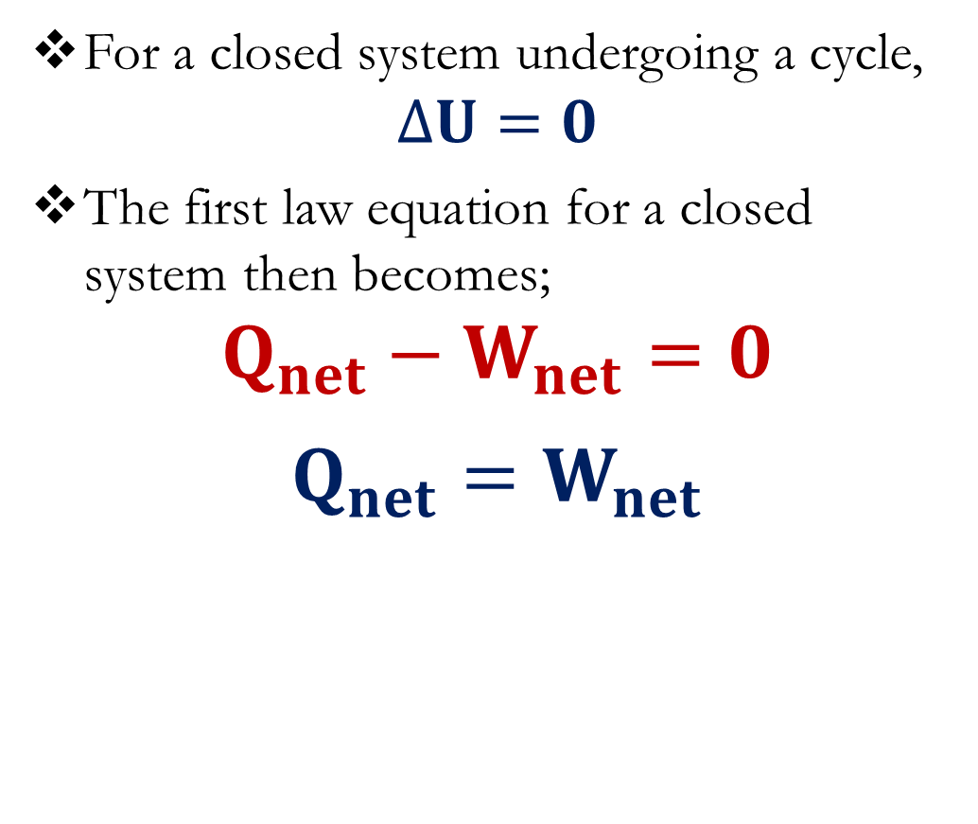
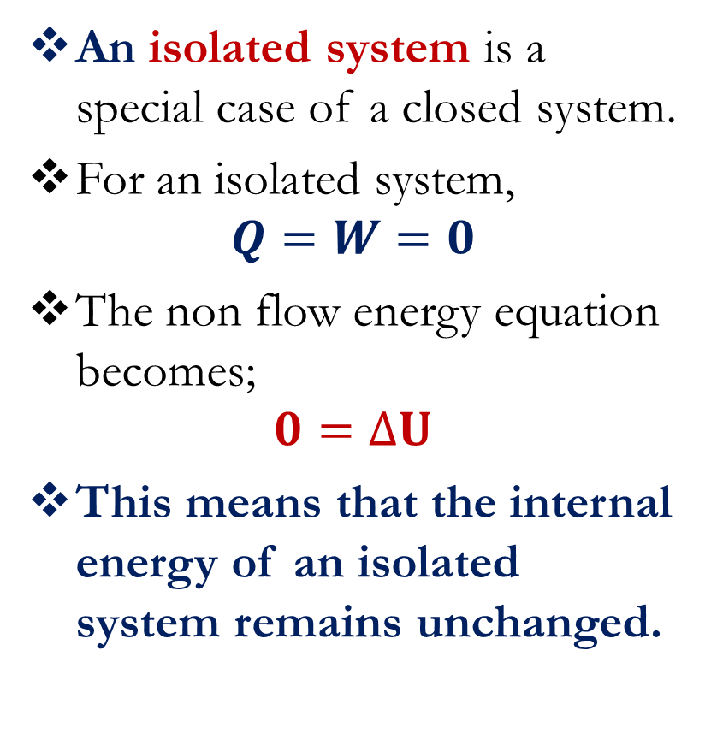
First Law of Thermodynamics
An isolated system is a special case of a closed system.
For an isolated system,
$$Q=W=0$$
The non flow energy equation becomes;
$$0=∆U$$
This means that the internal energy of an isolated system remains unchanged.
For a closed system undergoing a cycle,
$$∆U=0$$
The first law equation for a closed system then becomes;
$$Q_{net}−W_{net}=0$$
$$Q_{net}=W_{net}$$

Slide 4
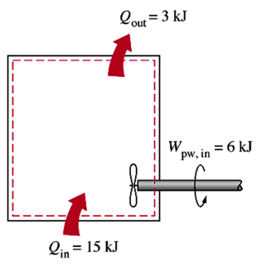
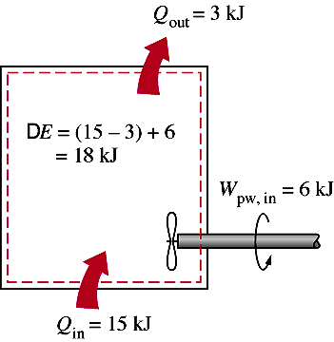


First Law of Thermodynamics
Example 1
Solution

Slide 5
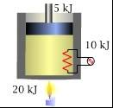
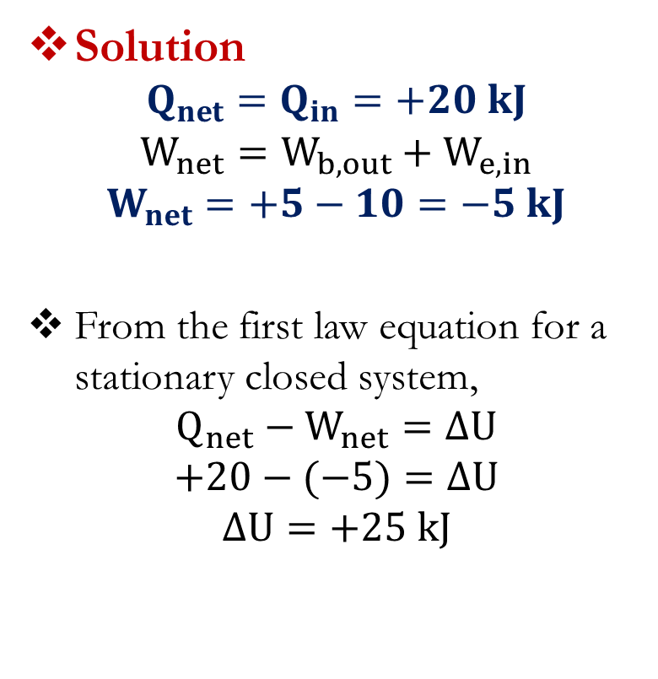
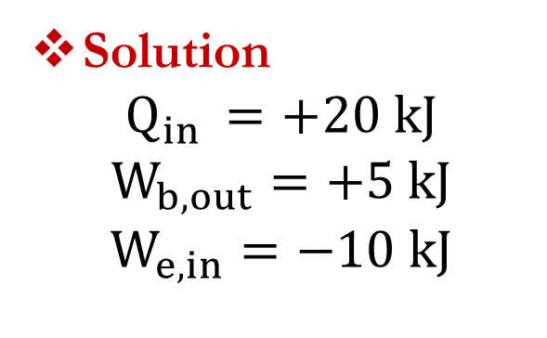
First Law of Thermodynamics
Example 2
A gas trapped inside a piston-cylinder device receives 20 kJ of heat while it expands performing a boundary work of 5 kJ. At the same time, 10 kJ of electrical work is transferred into the system. Evaluate Q, W and ΔU with appropriate signs.
Solution
$$Q_{net}=Q_{in}=+20 kJ$$
$$W_{net}=W_{b,out}+W_{e,in}$$
$$W_{net}=+5−10=−5 kJ$$
From the first law equation for a stationary closed system,
$$Q_{net}−W_{net}=∆U$$
$$+20−(−5)=∆U$$
$$∆U=+25 kJ$$
Solution
$$Q_{in }=+20 kJ$$
$$W_{b, out}=+5 kJ$$
$$W_{e, in}=−10 kJ$$

Slide 6
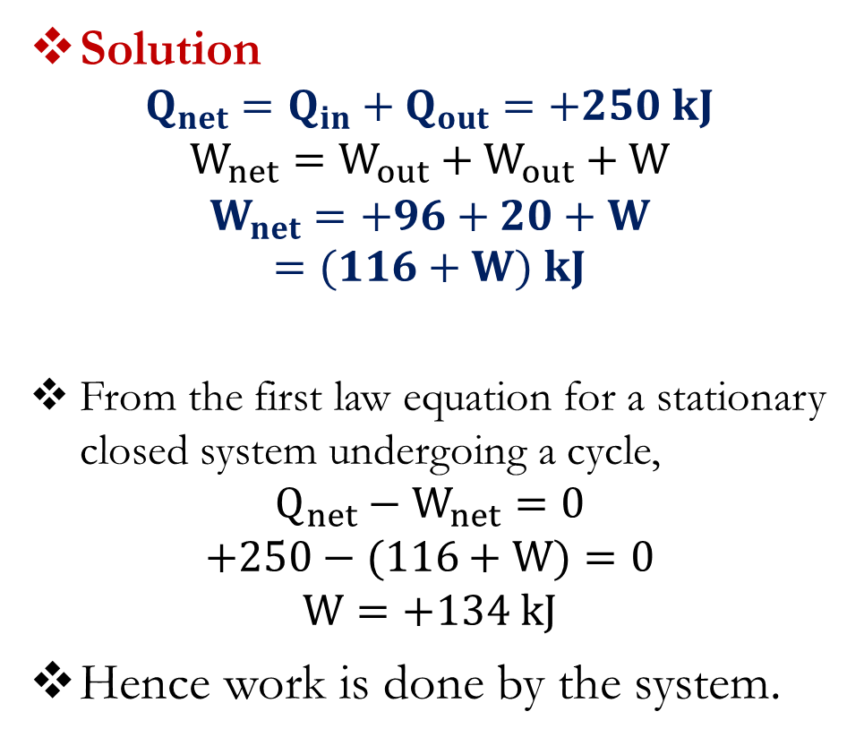
First Law of Thermodynamics
Solution
$$Q_{net}=Q_{in}+Q_{out}=+250 kJ$$
$$W_{net}=W_{out}+W_{out}+W$$
$$W_{net}=+96+20+W$$
$$=(116+W) kJ$$
From the first law equation for a stationary closed system undergoing a cycle,
$$Q_{net}−W_{net}=0$$
$$+250−(116+W)=0$$
$$W=+134 kJ$$
Hence work is done by the system.
Example 3
During a complete cycle of operations, a system is subjected to the following heat transfers; 800 kJ supplied and 550 kJ rejected. At two points, work is done by the system to the extent of 96 kNm and 20 kNm. At a third point, there is a further work transfer.
Determine its amount and state whether it is work done by or on the system.

Slide 7
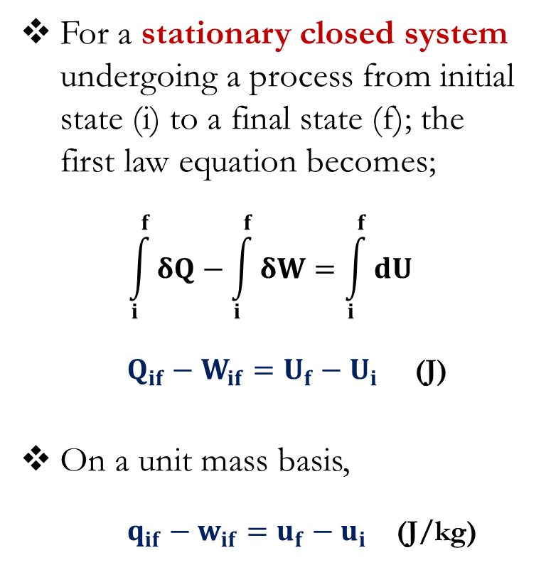
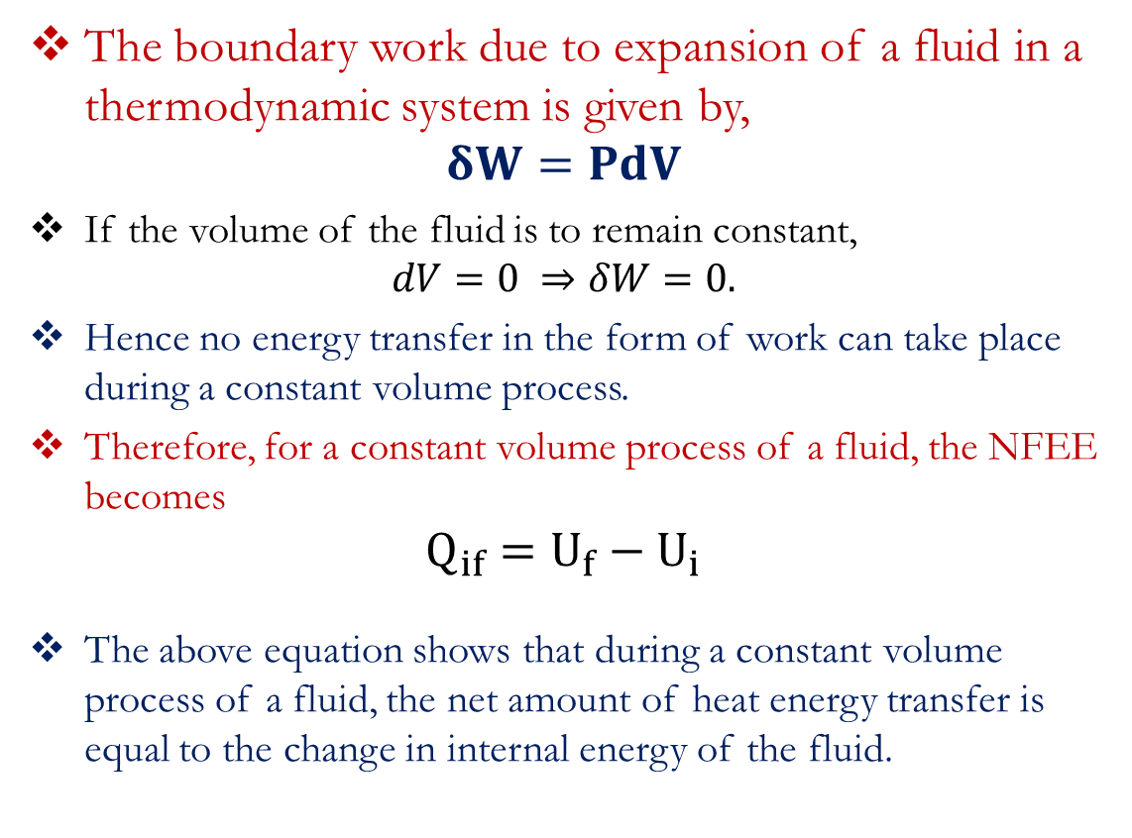
First Law of Thermodynamics
For a stationary closed system undergoing a process from initial state (i) to a final state (f); the first law equation becomes;
$$\int_{i}^{f}{δQ−\int_{i}^{f}{δW=\int_{i}^{f}{dU}}}$$
$Q_{if}−W_{if}=U_{f}−U_{i}$ (J)
On a unit mass basis,
$q_{if}−w_{if}=u_{f}−u_{i}$ (J/kg)
The boundary work due to expansion of a fluid in a thermodynamic system is given by,
$$δW=PdV$$
If the volume of the fluid is to remain constant,
$$dV=0 ⇒δW=0.$$
Hence no energy transfer in the form of work can take place during a constant volume process.
Therefore, for a constant volume process of a fluid, the NFEE becomes
$$Q_{if}=U_{f}−U_{i}$$
The above equation shows that during a constant volume process of a fluid, the net amount of heat energy transfer is equal to the change in internal energy of the fluid.

Slide 8

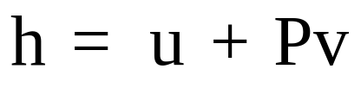
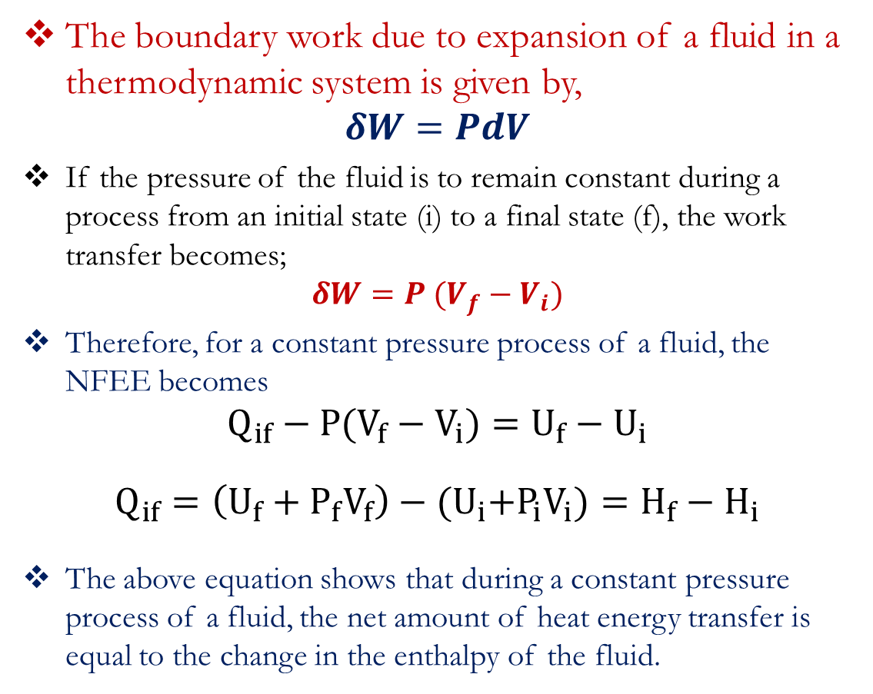
First Law of Thermodynamics
In thermodynamics, it is common to group properties when they appear consistently. A name is then given to the group.
One of such group is a property called enthalpy (H).
For specific enthalpy (enthalpy per unit mass),
The boundary work due to expansion of a fluid in a thermodynamic system is given by,
$$δW=PdV$$
If the pressure of the fluid is to remain constant during a process from an initial state (i) to a final state (f), the work transfer becomes;
$$δW=P (V_{f}−V_{i})$$
Therefore, for a constant pressure process of a fluid, the NFEE becomes
$$Q_{if}−P(V_{f}−V_{i})=U_{f}−U_{i}$$
$$Q_{if}=\left(U_{f}+P_{f}V_{f}\right)−{(U}_{i}+P_{i}V_{i})=H_{f}−H_{i}$$
The above equation shows that during a constant pressure process of a fluid, the net amount of heat energy transfer is equal to the change in the enthalpy of the fluid.

Slide 9
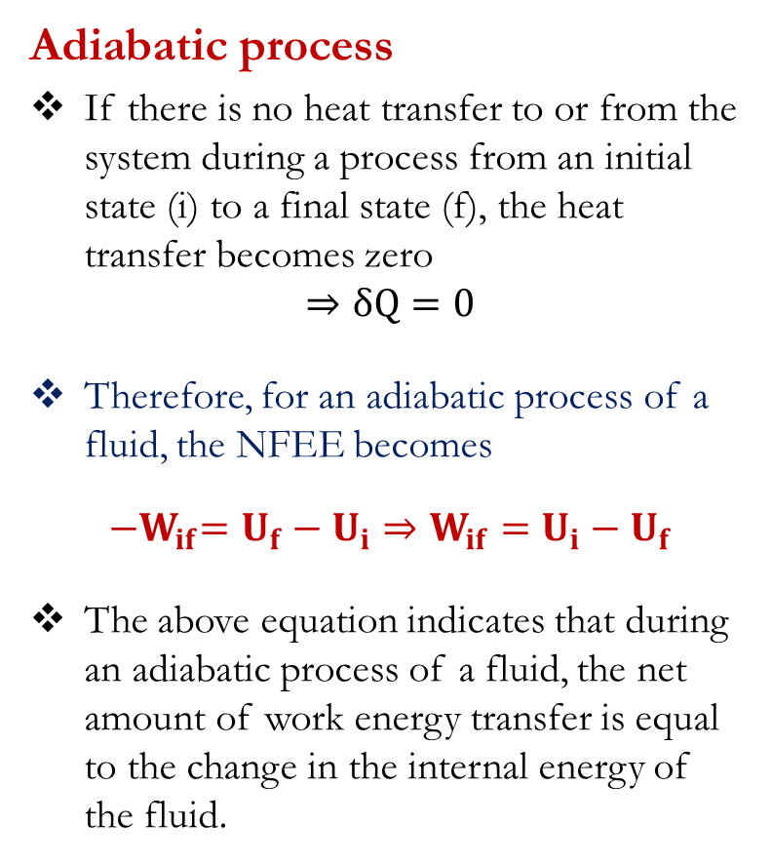
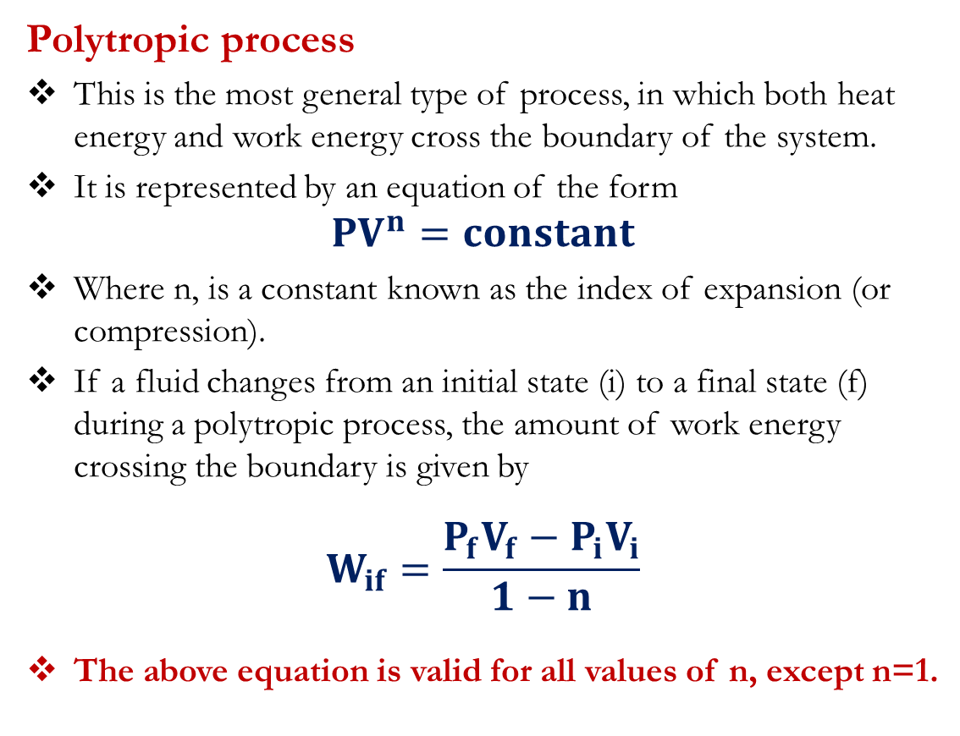
First Law of Thermodynamics
Adiabatic process
If there is no heat transfer to or from the system during a process from an initial state (i) to a final state (f), the heat transfer becomes zero
$$⇒δQ=0$$
Therefore, for an adiabatic process of a fluid, the NFEE becomes
$${−W}_{if}=U_{f}−U_{i}⇒W_{if}=U_{i}−U_{f}$$
The above equation indicates that during an adiabatic process of a fluid, the net amount of work energy transfer is equal to the change in the internal energy of the fluid.
Polytropic process
This is the most general type of process, in which both heat energy and work energy cross the boundary of the system.
It is represented by an equation of the form
$${PV}^{n}=constant$$
Where n, is a constant known as the index of expansion (or compression).
If a fluid changes from an initial state (i) to a final state (f) during a polytropic process, the amount of work energy crossing the boundary is given by
$$W_{if}=\frac{P_{f}V_{f}−P_{i}V_{i}}{1−n}$$
The above equation is valid for all values of n, except n=1.

Slide 10
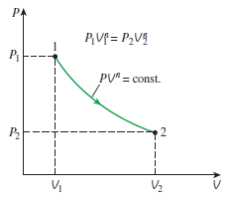
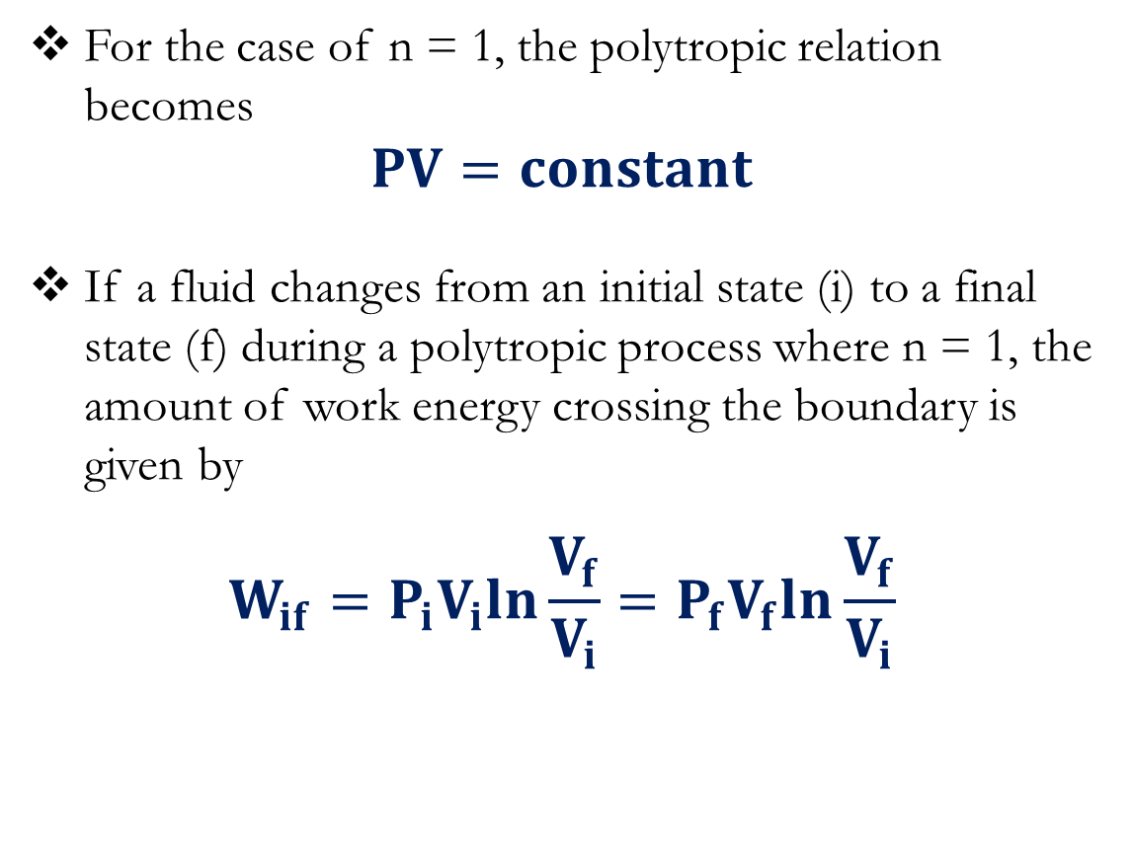
First Law of Thermodynamics
Polytropic process
A plot of pressure against volume for a polytropic process.
For the case of n = 1, the polytropic relation becomes
$$PV=constant$$
If a fluid changes from an initial state (i) to a final state (f) during a polytropic process where n = 1, the amount of work energy crossing the boundary is given by
$$W_{if}=P_{i}V_{i}ln\frac{V_{f}}{V_{i}}=P_{f}V_{f}ln\frac{V_{f}}{V_{i}}$$

Slide 11
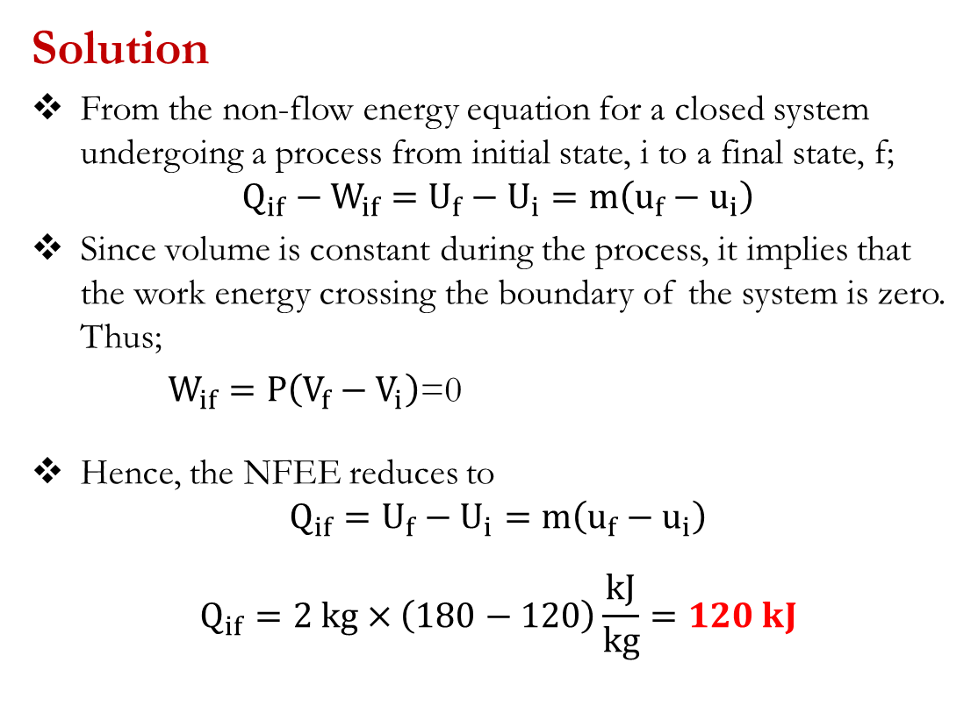
First Law for Closed Systems: Problems
Problem 1
The specific internal energy of a fluid is increased from 120 kJ/kg to 180 kJ/kg during a constant volume process. Determine the amount of heat energy required to bring about this increase for 2 kg of the fluid.
Suggested Answer: [120 kJ]
Solution
From the non-flow energy equation for a closed system undergoing a process from initial state, i to a final state, f;
$$Q_{if}−W_{if}=U_{f}−U_{i}=m\left(u_{f}−u_{i}\right)$$
Since volume is constant during the process, it implies that the work energy crossing the boundary of the system is zero. Thus;
$W_{if}=P\left(V_{f}−V_{i}\right)$=0
Hence, the NFEE reduces to
$$Q_{if}=U_{f}−U_{i}=m\left(u_{f}−u_{i}\right)$$
$$Q_{if}=2 kg×\left(180−120\right)\frac{kJ}{kg}=120 kJ$$

Slide 12
First Law for Closed Systems: Problems
Problem 2
2.25 kg of a fluid having a volume of 0.1 m³ are contained in a cylinder at a constant pressure of 7 bar. Heat energy is supplied to the fluid until the volume becomes 0.2 m³. If the initial and final specific enthalpies of the fluid are 210 kJ/kg and 280 kJ/kg, respectively, determine,
(a) the quantity of heat energy supplied to the fluid
(b) the change in internal energy of the fluid.
Suggested Answer: [(a) 157.5 kJ; (b) 87.5 kJ]

Slide 13
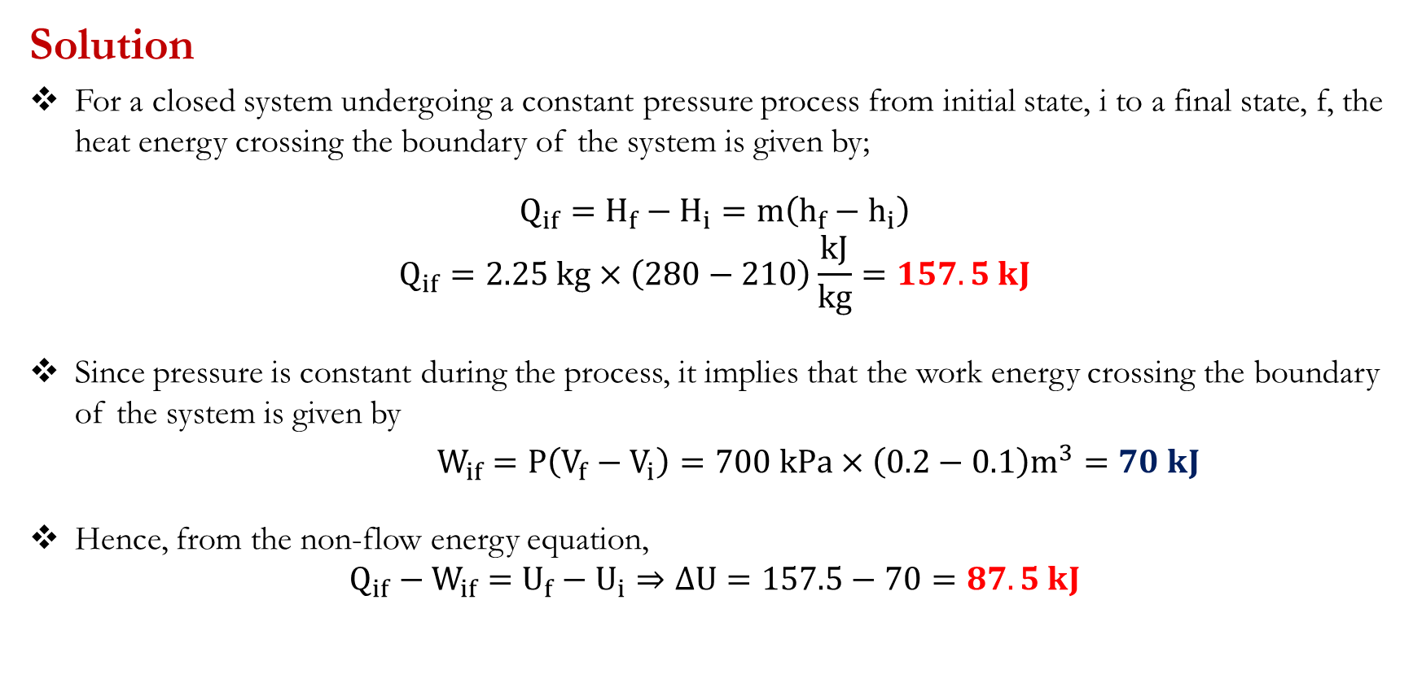
First Law for Closed Systems: Problems
Solution
For a closed system undergoing a constant pressure process from initial state, i to a final state, f, the heat energy crossing the boundary of the system is given by;
$$Q_{if}=H_{f}−H_{i}=m\left(h_{f}−h_{i}\right)$$
$$Q_{if}=2.25 kg×\left(280−210\right)\frac{kJ}{kg}=157.5 kJ$$
Since pressure is constant during the process, it implies that the work energy crossing the boundary of the system is given by
$W_{if}=P\left(V_{f}−V_{i}\right)=700 kPa×\left(0.2−0.1\right)m^{3}=70 kJ$
Hence, from the non-flow energy equation,
$$Q_{if}−W_{if}=U_{f}−U_{i}⇒∆U=157.5−70=87.5 kJ$$

Slide 14
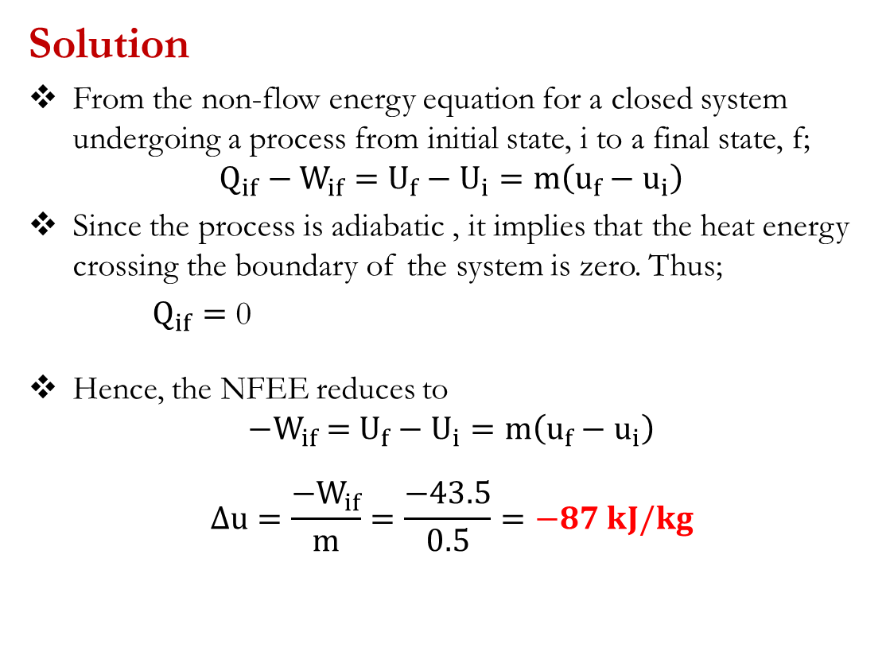
First Law for Closed Systems: Problems
Problem 3
During an adiabatic expansion process, 0.5 kg of fluid transfers 43.5 kJ of work energy. Determine the change in specific internal energy of the fluid during the process.
Suggested Answer: [-87 kJ/kg; The internal energy decreases during the process]
Solution
From the non-flow energy equation for a closed system undergoing a process from initial state, i to a final state, f;
$$Q_{if}−W_{if}=U_{f}−U_{i}=m\left(u_{f}−u_{i}\right)$$
Since the process is adiabatic , it implies that the heat energy crossing the boundary of the system is zero. Thus;
$Q_{if}=$ 0
Hence, the NFEE reduces to
$${−W}_{if} =U_{f}−U_{i}=m\left(u_{f}−u_{i}\right)$$
$$∆u=\frac{{−W}_{if}}{m}=\frac{−43.5}{0.5}=−87 kJ/kg$$

Slide 15
First Law for Closed Systems: Problems
Problem 4
A cylinder contains 0.07 kg of fluid having a pressure of 1 bar, a volume of 0.06 m³ and a specific internal energy of 200 kJ/kg. After polytropic compression, the pressure and volume of the fluid are 9 bar and 0.0111 m³, respectively, and the specific internal energy is 370 kJ/kg. Determine,
(a) the amount of work energy required for the compression
(b) the quantity and direction of heat energy flow during the compression.
Suggested Answers: [(a) -13.2 kJ; (b) -1.3 kJ]

Slide 16
First Law for Closed Systems: Problems
Problem 5
A piston–cylinder device containing 25 g of fluid expands at a constant pressure of 300 kPa. The initial specific enthalpy of the fluid is 2725kJ/kg. A resistance heater within the cylinder is turned on and passes a current of 0.2 A for 5 min from a 120-V source. At the same time, a heat loss of 3.7 kJ occurs. Determine the final specific enthalpy of the fluid.
Suggested Answer: [2865 kJ/kg]
Problem 6
A quantity of fluid occupies 0.56 m³ at 1 bar. After a compression which follows the law PV^{n} = constant, the pressure and the volume are 6.3 bar and 0.14 m³ respectively. Calculate the value of the index, n and the work energy transfer.
If the internal energy of the fluid increases by 85 kJ during the process, calculate the heat energy transfer.
Suggested Answers: [(a)1.328; -98.2 kJ; (b) -13.2 kJ]

Slide 17

KNUST-SESC

